Slide 1
RC model
By: Aryan Rajesh Aher

Slide 2
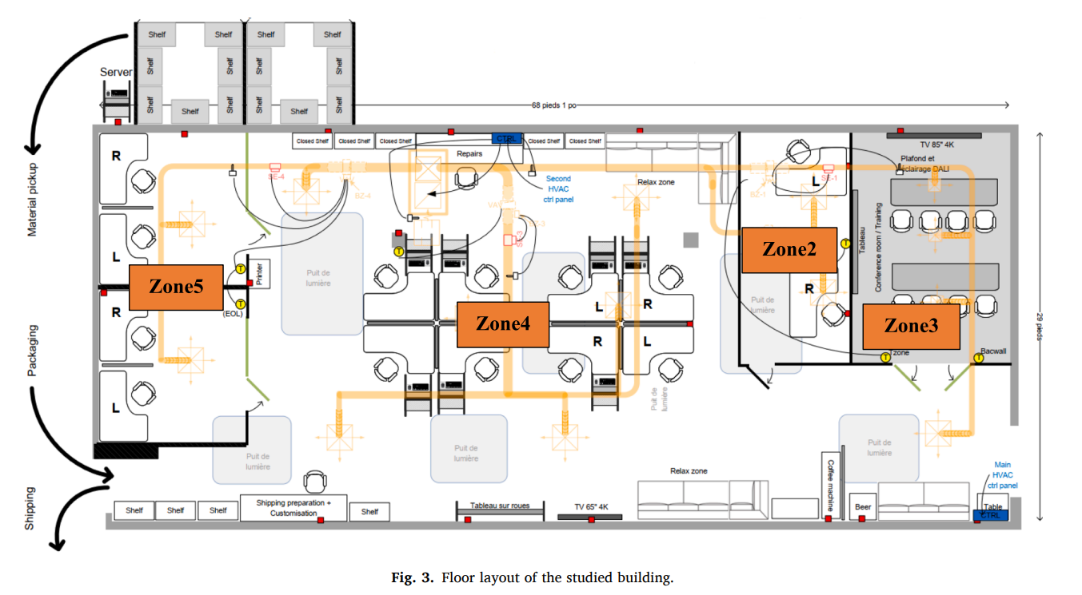
Floor Plan

Slide 3
Assumptions
Heat transfer through the walls, windows, and other surfaces is assumed to be linear, following Fourier's law of heat conduction.
Each zone is assumed to have a uniform temperature distribution, neglecting temperature gradients within the zone.
Thermal properties such as thermal conductivity, specific heat capacity, and density are assumed to be constant and not varying with temperature.
Air exchange between the inside and outside environments, except through specified ventilation or openings, is neglected.
Heat generated by occupants and electrical systems is neglected in the model.

Slide 4
Modelling
The room is modeled using equivalent thermal capacitance (C) and thermal resistance (R) elements, which simplify the complex thermal dynamics into a manageable RC network.
All zones within the building are interconnected through openings, allowing air to flow freely between them.
For simplification and control purposes, all zones are combined into a single, unified model.
The average temperature of all zones is used to represent the overall temperature of the combined area.
The heat input to the zones is considered to be equal to the heat lost by the air flowing across the zones.
Solar energy and outside air temperature data are obtained from weather reports and used as inputs in the model.

Slide 5
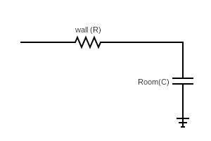
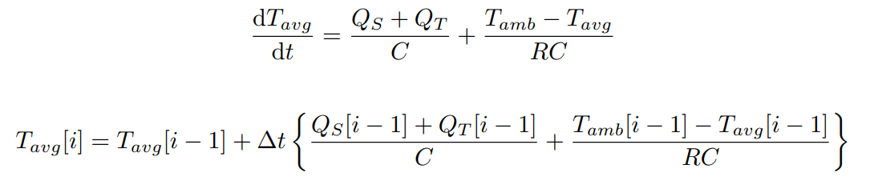
The RC model
T_amb
T_avg
T_amb = Outside Air Temperature, T_avg = combined zone Temperature
Q_s = Solar heat input, Q_T = thermal heat input through HVAC.
R = thermal resistance of the walls.
C = Thermal Capacitance of the rooms.
Delta = time step (5 mins)

Slide 6
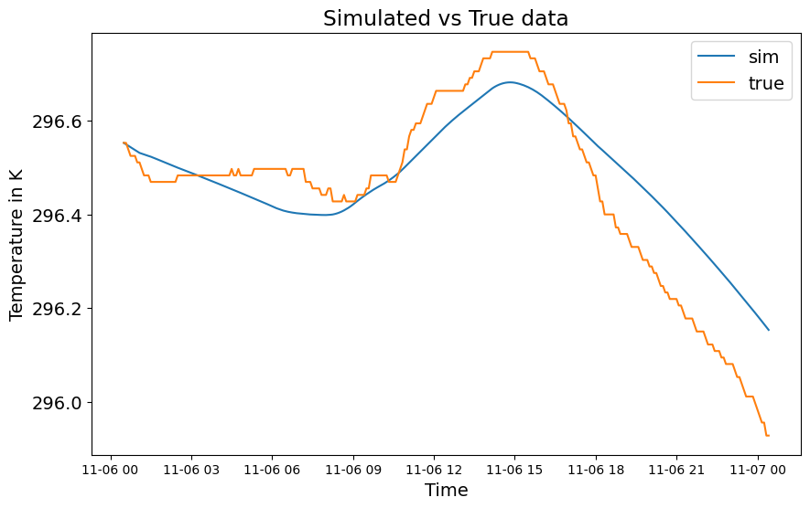
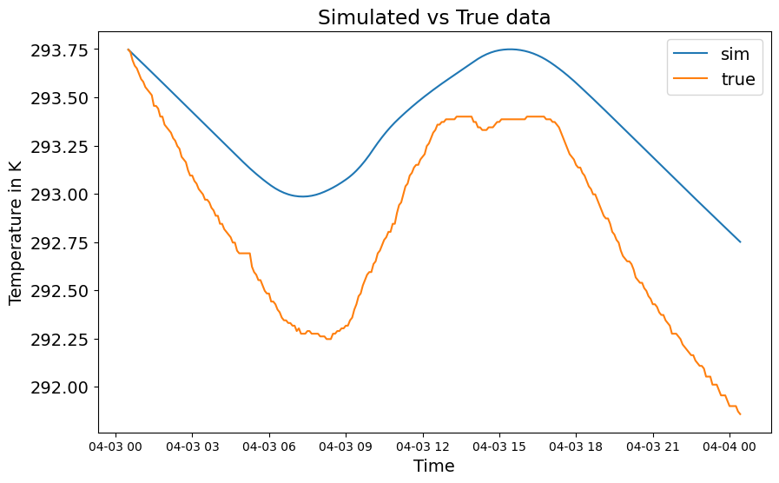
Results: some prediction comparisons

Slide 7
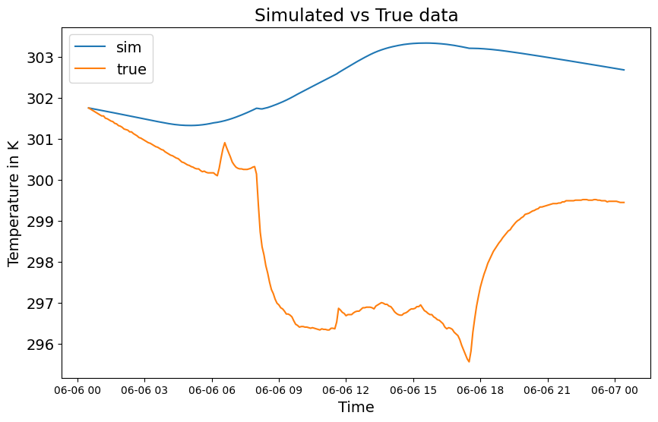
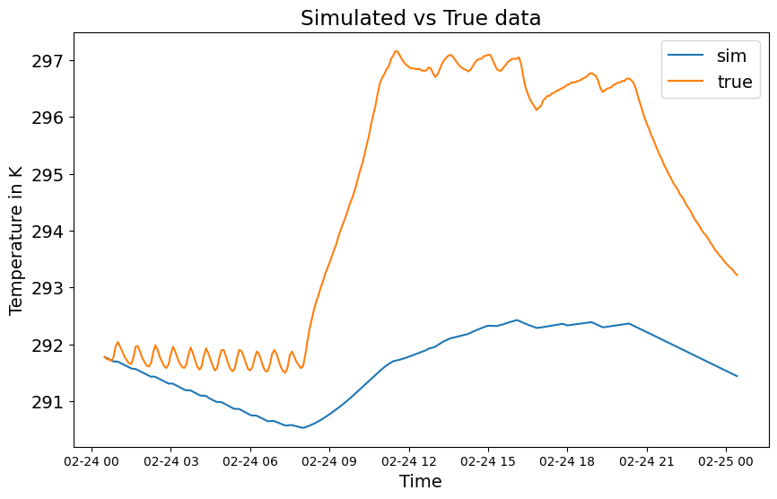
Some worse performing days:

Slide 8
Results
When tested on a day, the model gave following results (The averages were calculated over the whole year.)
Average mae error = 1.03 C
Mean RMSE = 1.26 C

